Slide 1

Introduction to Python

Slide 2
Usage of Python
Data analysis
Web development
Machine learning
Notes:
Possible questions:
- What are you thinking of with this subject?

Slide 3

Example
What do you think this will do?

Slide 4
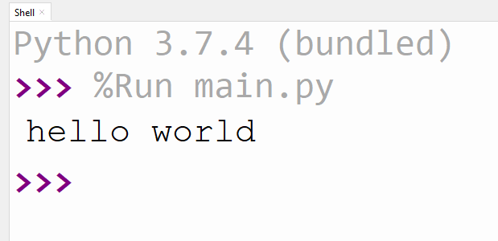
Example

Slide 5
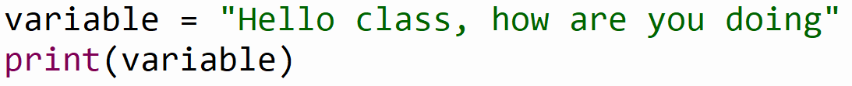
Example
What do you think this will do?
Notes:
Ask if everyone knows what a variable is

Slide 6
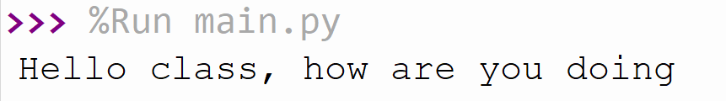
Example

Slide 7
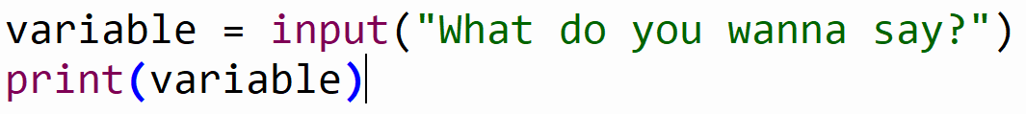
Example
What do you think the input function will do?

Slide 8
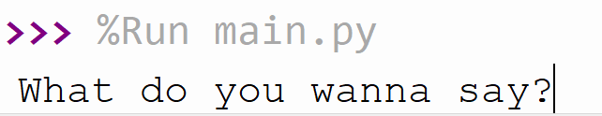
Example

Slide 9
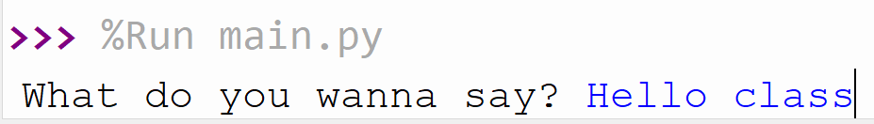
Example

Slide 10
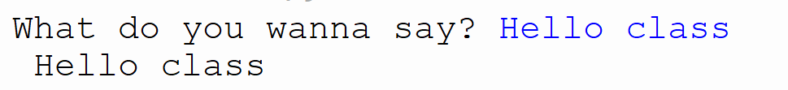
Example

Slide 11
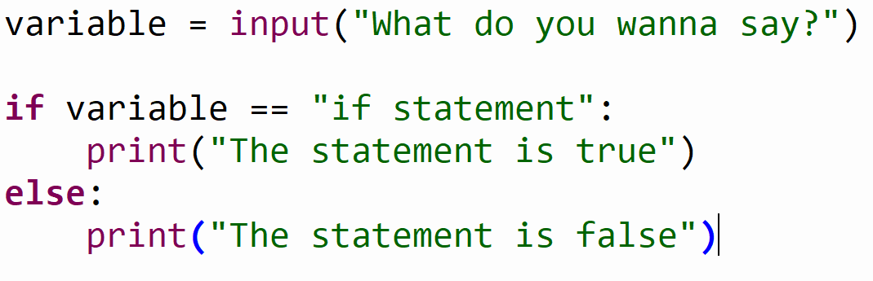
Example
What does the if/else statement do?

Slide 12
Example
What will be printed if variable is “if statement”

Slide 13
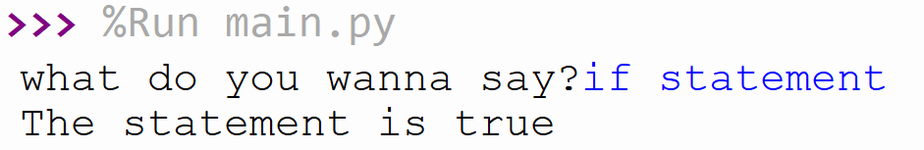
Example

Slide 14
Assignment (25 min)
Install Thonny from https://thonny.org/
Create a Python file that will:
Ask the user for an input
Puts the input from the user in a variable
Use the if statement to check if the input is your own name
If the input equals your name then print ‘this is my name’
If the input is not your name then print ‘this is not my name’
Notes:
Show how to create a file in Thonny
25 min is inclusive of thonny installation

Slide 15
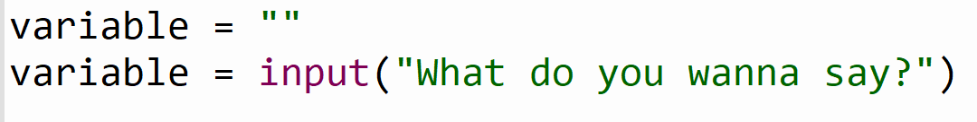
Example
What will happen to the variable?
It will be overwritten by the input

Slide 16
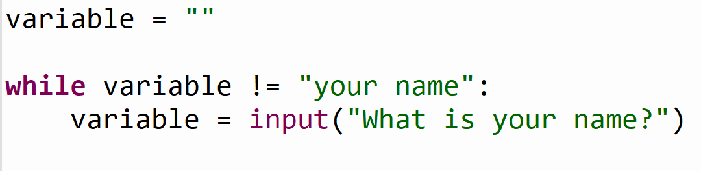
Example
What will the while do?

Slide 17
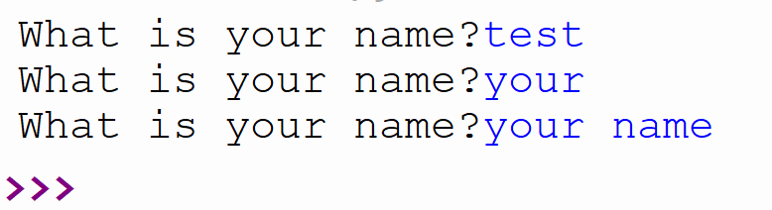
Example

Slide 18
Assignment (10 min)
Extend your previous assignment with the while loop so it will keep asking you until you successfully enter your name.

Slide 19

Example
What will happen if we write: hello

Slide 20
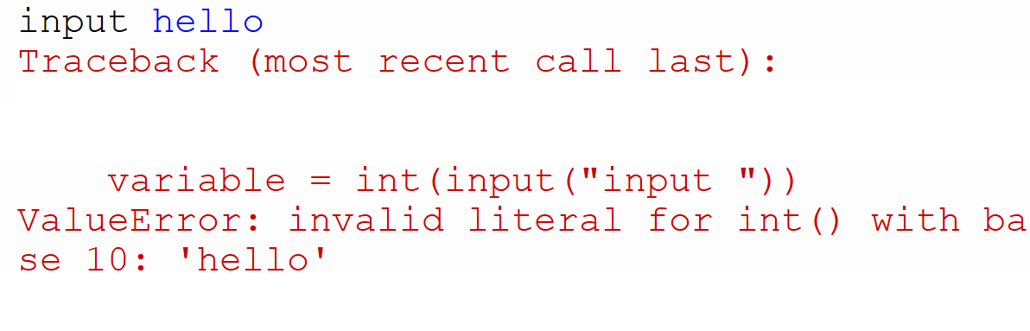
Example

Slide 21
Example
What will happen if we write: 10

Slide 22
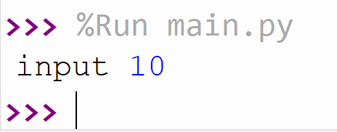
Example

Slide 23
Assignment (5 min)
Extend your program by asking for your age.
Use the while loop to do this until you get your age right.

Slide 24
Summary
Installed Thonny
print(“Hello world”)
Variables
variable = “hello world”
print(variable)
input(“Enter something: ”)
if & else statement
while() loop
int(input())

